Slide 1
Conflict, Politics, institutions
Tensions in analysis, and lessons from Cambodia and the Pacific
David Craig and Doug Porter

Slide 2
Tensions in political and institutional analysis of post conflict arrangements
Normative/ Instrumental
Critical
Positive
ESID: ‘What kind of politics can help secure inclusive development, and how can these be promoted?
‘…an ‘adapted political settlements ‘ approach that draws in important insights from the broader realms of political theory, and particularly from more critical approaches’

Slide 3
Basic cleavages in analysis: Political economy and Institutional approaches
Whether the political settlement/ economy that matters is structurally antecedent and super-ordinant to the pacting and its institutionalisation
Or whether the pacting and its institutionalisation can constitute a real rupture, and generate subsequent, predictable change in the basic political settlement via incentivised agency
Temporal questions, but also related to scale, agency and limits of impact (layering)
The wider question of whether instrumentalisation is possible
ESID (and us) wanting to work across these tensions

Slide 4
Combining political economy and institutional perspectives in positive/ critical analysis?
Khan: elites and rents; institutional formality and informality
Slater: ‘infrastructural grasp’ of elites, and the basic nature of the pact (protection and provisioning), stable vs fragmented outcomes
Hickey: political settlement and open access orders, located within wider critical accounts of hegemony, political economy

Slide 5
MID-level Political-Institutional capabilities analysis Basic structuration meets NI: Capabilities (‘grasp and reach’) and agency Pacting context: protection and provisioning (Critical) political settlement/ economic context
modalities/ rules/ executive function
rents/ resources/ finances
roles/ enrolments/ relationships/ political agency

Slide 6
Winning the Peace in Cambodia: MIDLEVEL Logics of Translation, Evasion, layering, Hybridity
A 25 year retrospect of a decentralisation / local development programme: ‘Seila’
‘Poverty reduction and environmental protection through good governance’
How the program’s modalities were translated into Cambodian contexts
How the programme was co-opted, adapted and imitated by enrolled political actors trying to settle politics
Protection and provisioning contexts; Comparative grasp and reach of modalities and resources
How ‘multi-hat wearing’ actors (local and international) were enrolled by neoliberal contracting modalities and wider assemblages
Longer term institutional layering issues: something which tried to coordinate but ended up layering/ evading

Slide 7
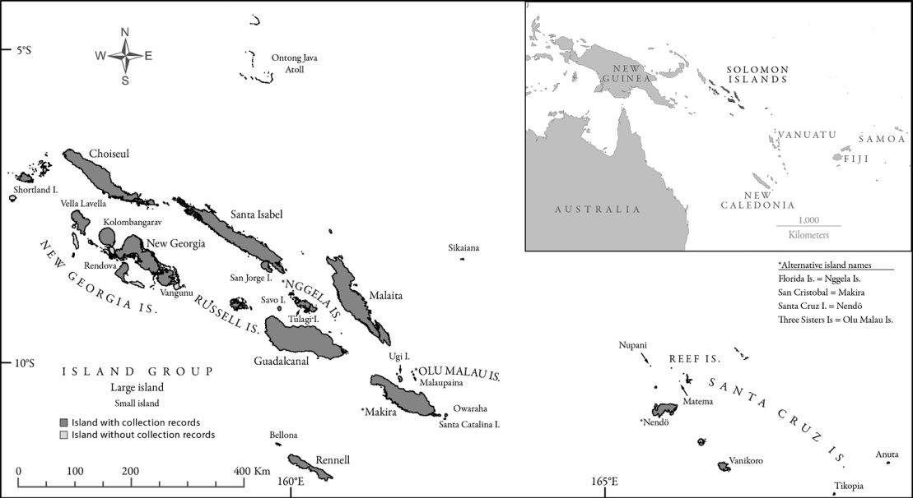
Not your typical nation state

Slide 8
Segmentary societies

Slide 9
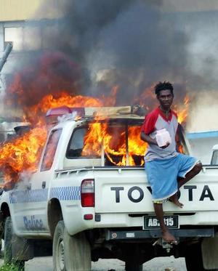
The solomons in conflict

Slide 10
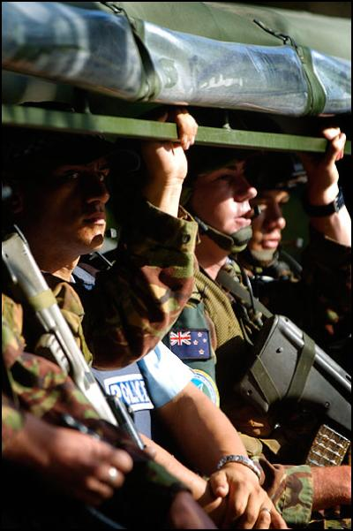
Intervention: RAMSI

Slide 11
Three Mid-level logics of post conflict institutional capability In Solomon Islands
Geopolitics and the primacy of provisioning
Ethnic cleavage, clientage and transactionalisation of pacts
Institutional co-production, evasion and layering

Slide 12
Political-Institutional capability Logic 1: Geopolitics and The Primacy of Provisioning
Dispersed constituencies, central political pacts
Weak party/ pact enrolment: dissolution of governments through confidence votes
Urban primacy, central and local rents
Weak modality reach: enormous problems in provisioning, and in expressing political agency through government machineries

Slide 13
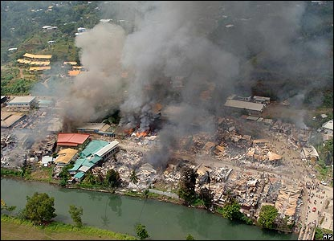
Political-Institutional Capability Logic 2: Ethnic cleavage and the transactional-isation of pacts
Problems of elite cohesion, protection and concessionary provision
Clientage, security and elite -provisioning
Cash nexus transactions seeking enrolement across the ethnic divide
The transactionalisation and monetisation of elite political economic pacts

Slide 14
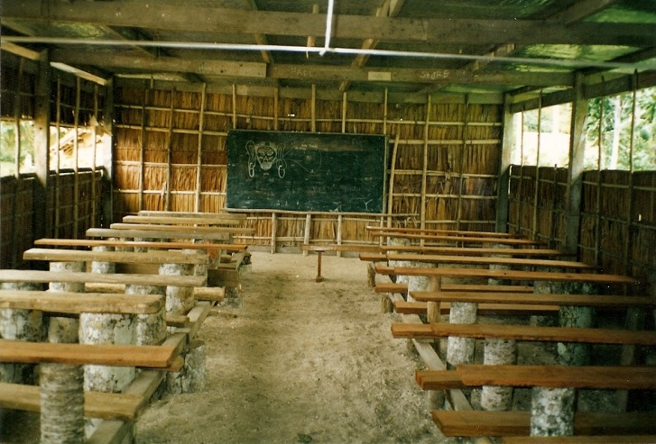
Political-Institutional capability Logic 3: Co-production and layering
Co-production: massive international presence in security, justice, health and education, public finance
Political agency/ enrolment eroded in mainstream public provision and resourcing
Channelling resources into modalities where they can be used to enrol political support: Constituency Development Funds
Ongoing raiding of co-produced budgets for new layered capabilities

Slide 15
Superordinant structure vs intervention AGENCY? Novel structurations via Institutional layering
Institutional outcomes are not set in stone by political economy (but retrospect will show that political economy contained many, many clues, especially as to pre-disposing institutional capabilities)
Outcomes emerge, intended and unintended, over time, and in a range of temporal relations of capability reinforcement or corrosion, evasion and adaptation
Layering can and does produce surprising results over time: fragmentation, but also hybridity and places for ‘multi-hat wearers’ and political actors to hide, adapt , learn, reform

Slide 17
1. Political economy as antecedent
The politics/ political economy that matters is antecedent to the pacting and its institutionalisation
Macro/ deterministic focus on
The nature of the (political) economy, the nature and scale of production, the kinds of rents available
Macro focus on the nature of Political and economic geography, scale, ethnic divisions, political and economic elites and their alliances

Slide 18
2. Institutional change and how it happens Subsequent to intervention
Whether the pacting and its institutionalisation can constitute a real rupture, a reforming moving, a change in the basic political settlement
Classic Historical Institutional analysis of critical juncture, path dependency, cycles of return
New Institutional analyses of incentives, transactions, rational acting, open and restricted access orders
Instrumentalised political approaches: social accountability, g7+ New Deal pactings, imagined sequencings

Slide 19
Our analysis
Analytic framings that can work across different levels of scale and temporal framings
up to and down from political economy and its timeframes
down into everyday institutional/ modality arrangements and their transformational outcomes in intervention timeframes, and from there back up into political economy
Mid level logics, placed in locations, that combine political economy and institutional processes
Empirical and other engagement with programmes on the ground, especially in post conflict subnational governance/ justice

